Slide 1


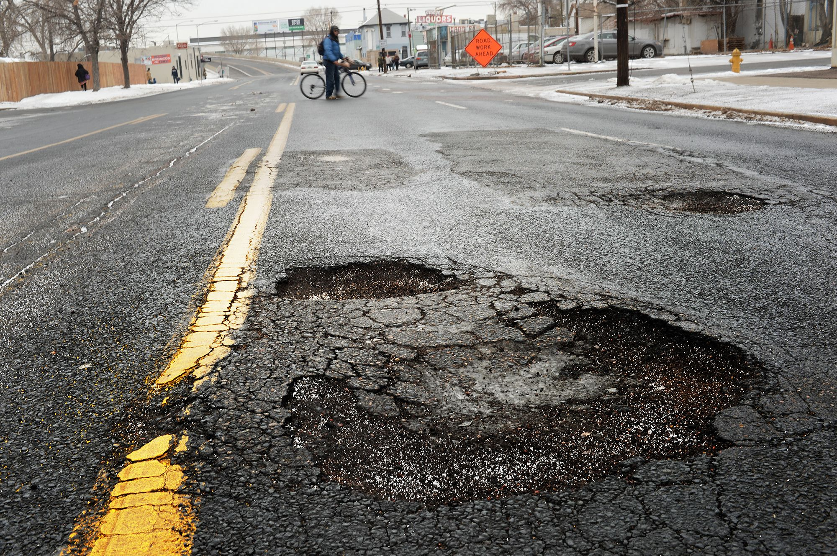
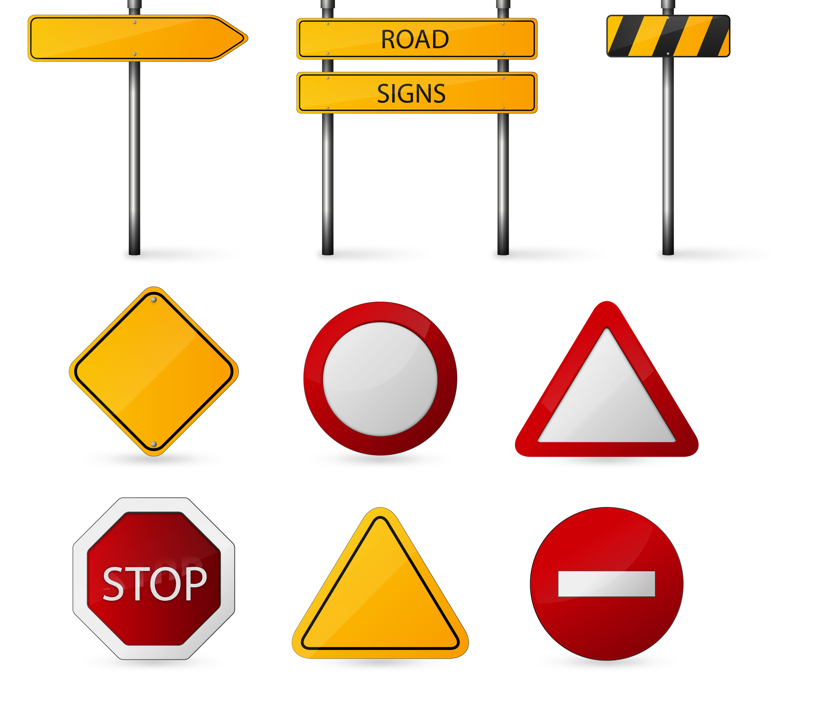


Road Health Monitoring Network
PROBLEM STATEMENT :: India has a total of about 2 million kilometers of roads , out of which about 1 million are poorly constructed (with dents, potholes, broken parts). These road conditions lead to severe problems like (Accidents, Traffic, Water clogging, Damage to vehicle, Poor aesthetics etc.), This not only affects our economy but our image on the global scale. Despite huge expenditure on road repair by government, Delayed actions by Authorities due to insufficient data about road condition delay its solution. What we need is a system that can do the DATA ACQUISITION and can aid in diagnostics process of road repair.
Team number : NA
Category : Smart City/Vehicle
Level : Idea
Team : SHUNNYA
Leader: Ridham Bhat
THIS WAY
Members : Nikhil, Naman, Vedant, Sayantanu, Riya, Ridham.

Slide 2

“ Diagnosis is the first step towards cure ”, this is what our idea is based upon, a real time ROAD CONDITION MAPPING NETWORK ,We have devised a system that can model the road conditions in an area (through sensor data) and can prioritize fixing a particular road by judging criteria like unevenness, traffic speed, traffic type and busyness of a road , using a machine learning model in every car.
Our Solution : We plan to implant easily available sensors such as Accelerometer in smart vehicles so that we get a real time status of any irregularities like (jerks, bumpiness, broken road etc.) in roads, which can be recorded and labelled using machine learning model (every model gets adjusted it’s cars dynamics), this particular road data with GPS information is then updated on the database, which judge from a collection of data points(from different vehicles), the condition of that road . this data can then be used to decide fixing roads which will make the maximum impact upon repair and hence will make the most effective and optimized use of resources. This ROAD HEALTH MAP , if made public will create an accountability for the authorities to repair road within a stipulated time period after occurrence.
Our Technology stack : We have made use of high tech yet easy to use these days technologies such as MEMS sensors, machine learning, Database in our project.

Slide 3

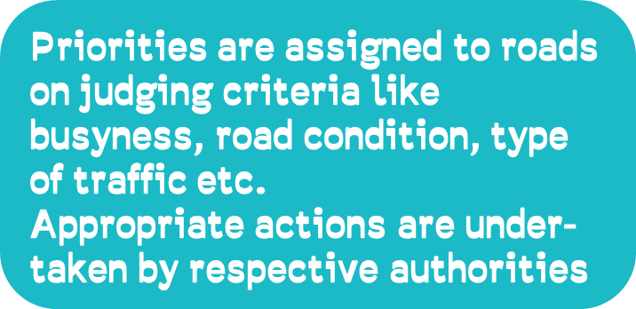

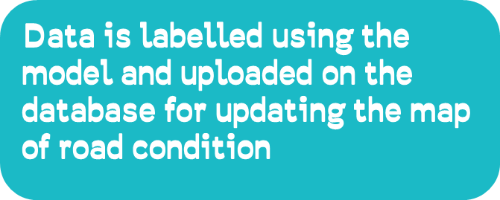
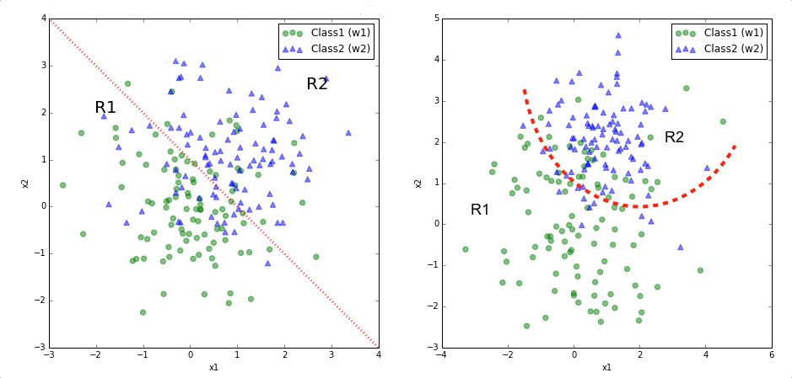


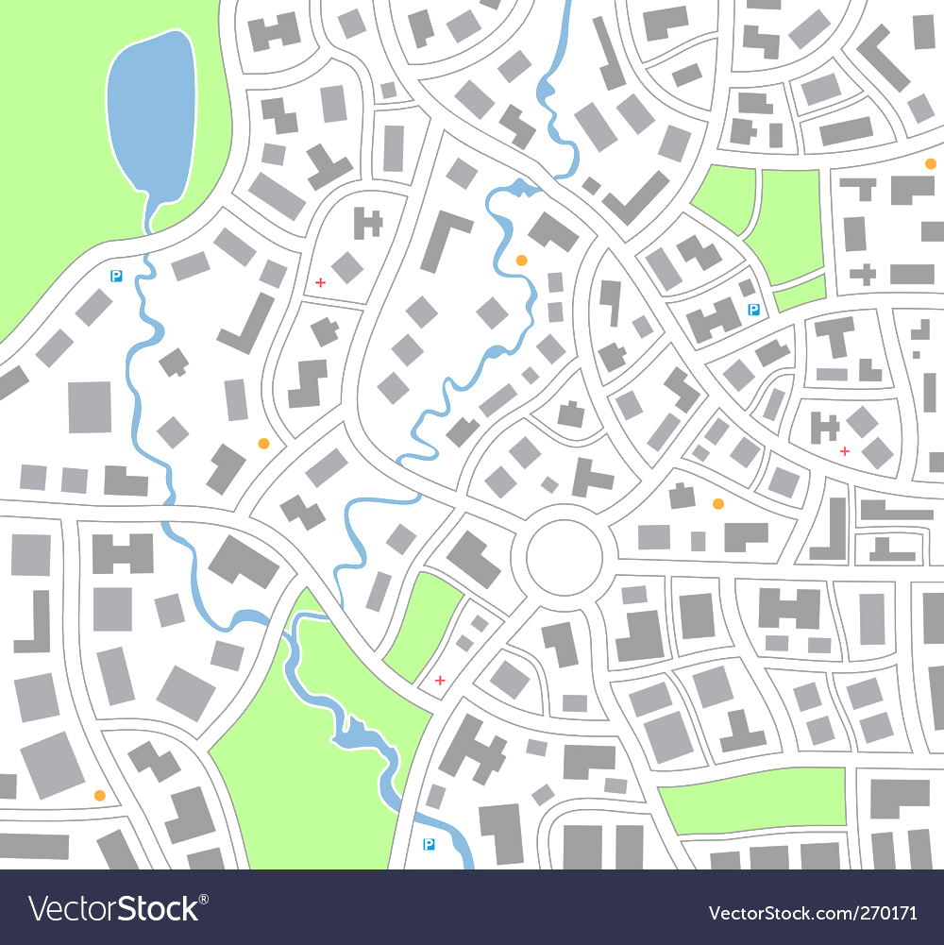
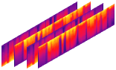
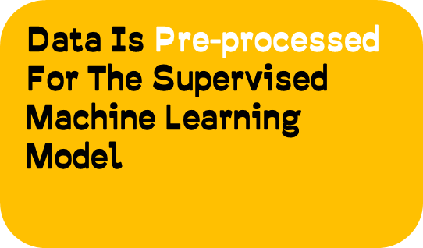
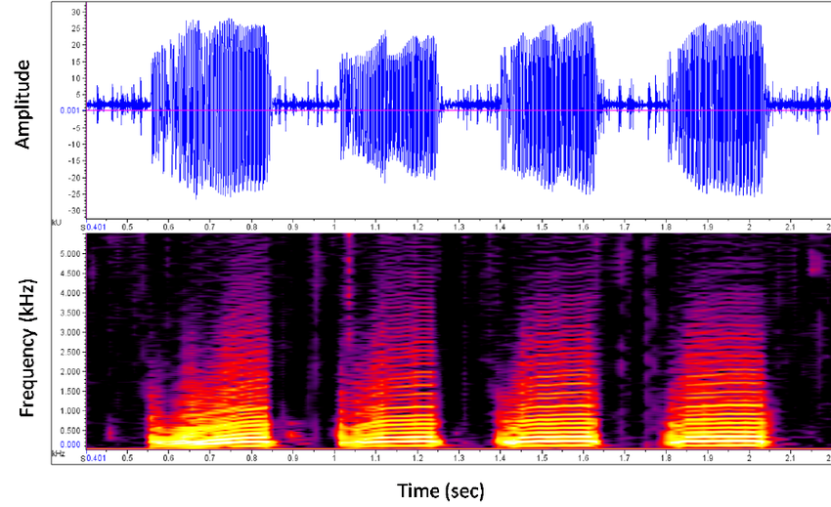

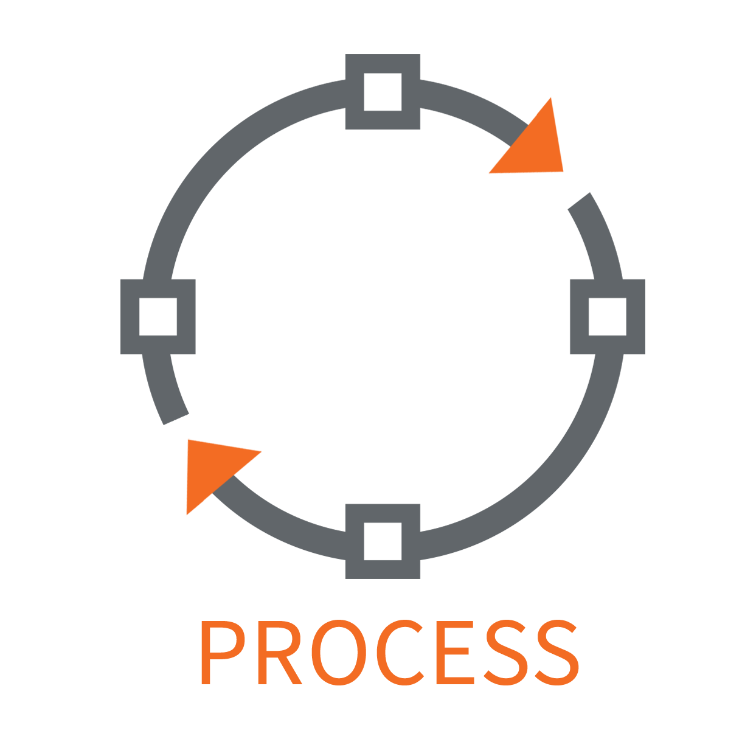
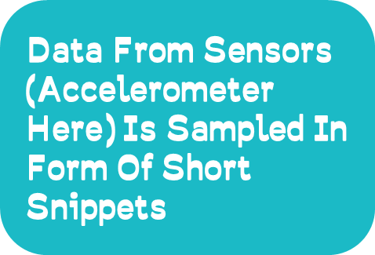
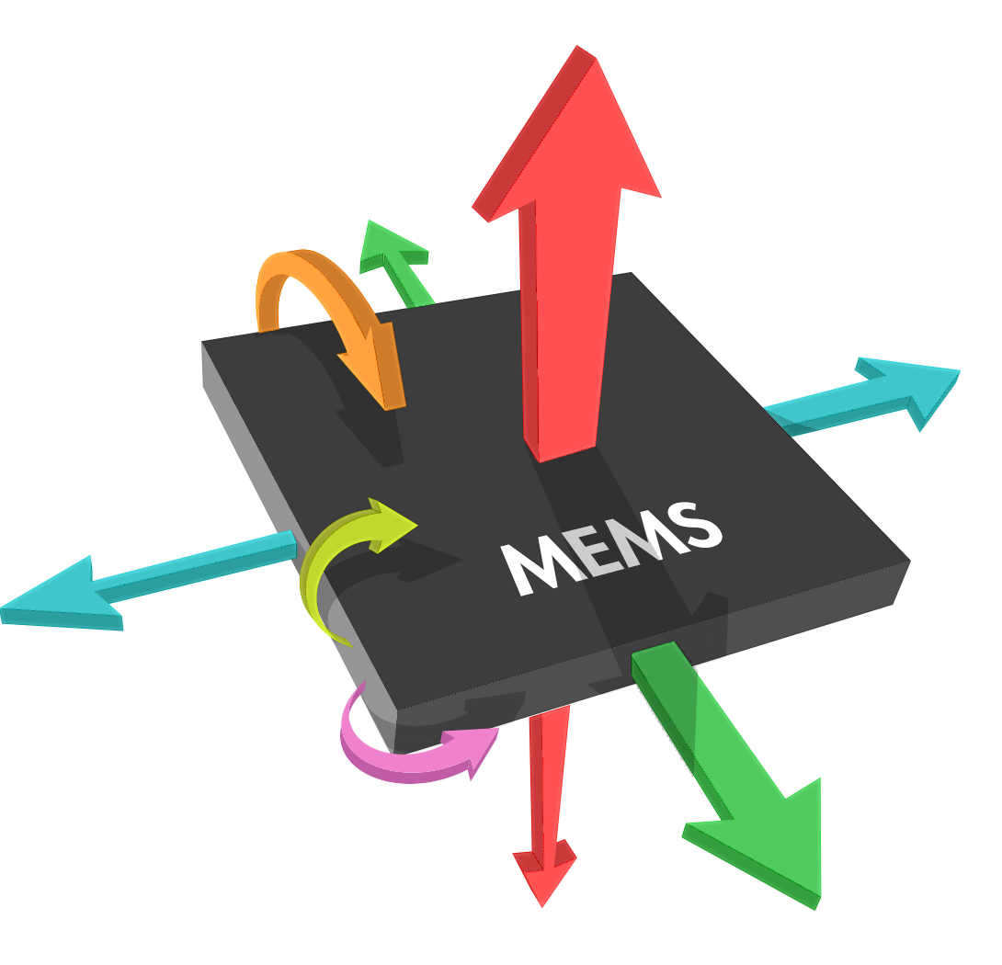

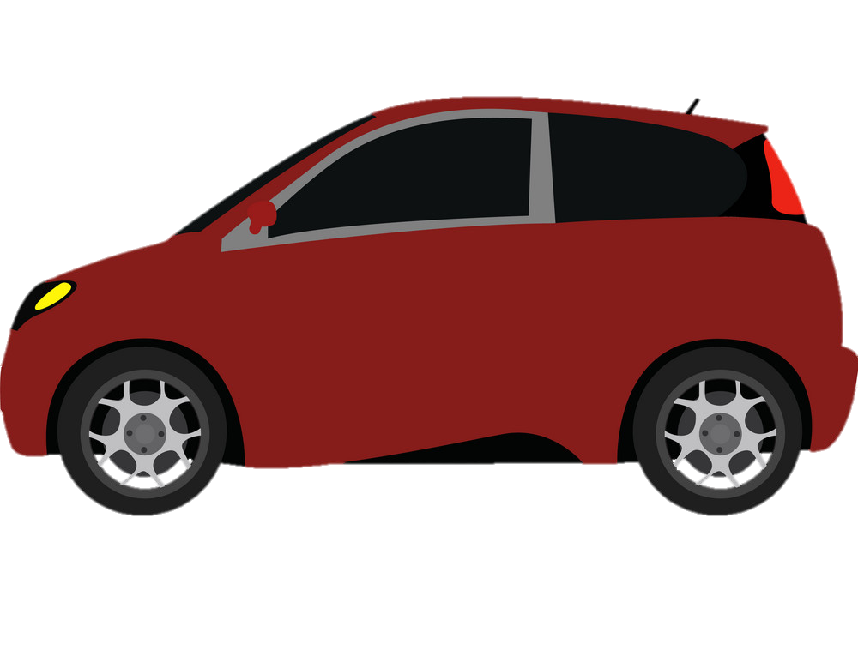
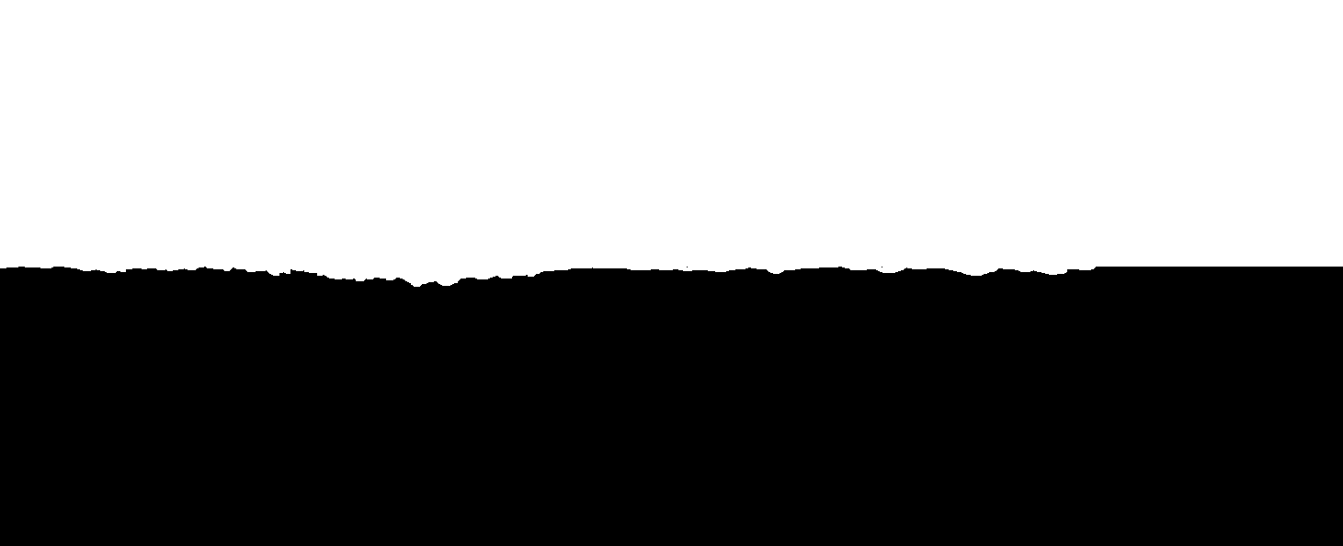


How Will It All Work ?
x-axis
y-axis
z-axis

Slide 4
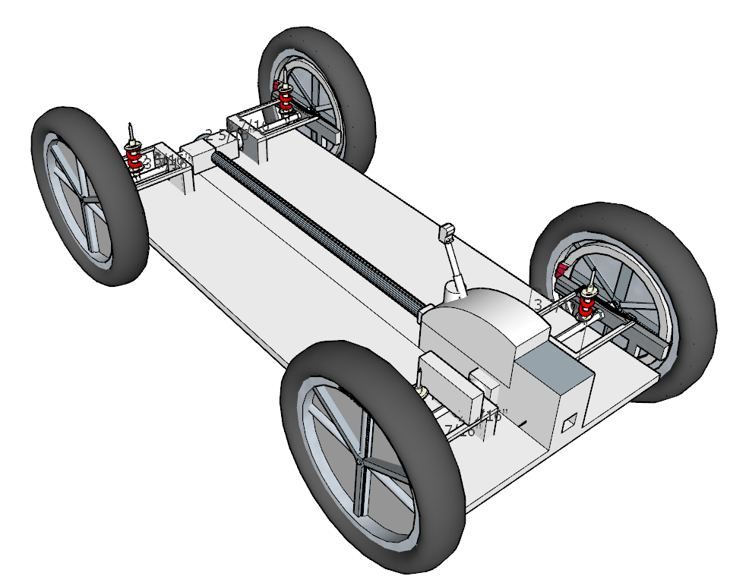

USE CASE :: We plan to implant easily available sensors such as Accelerometer , the data form accelerometer will be in form of short snippets all of which will be labeled by the machine learning model which will get trained as per every car’s dynamics for accurate labelling , this way irregularities such as speed breakers will be distinguished from potholes , this data will be (buffered until uploaded) uploaded on to the cloud database, which from collection of data judges the actual condition of road.
Our Idea’s Limitations :
Installation of the system in current vehicle : it will easier to integrate this system in smart vehicles in future , but for now we can initialize this system with cab services (like uber and ola) as they operate on almost all the major roads within a city also providing a continuous internet connectivity to our system.
This Data will not be of any use unless the government Acknowledges its impact and takes action accordingly

